Slide 1
Images in Isaiah

Slide 2
Reflections
Watch the slide show which is simply Isa 46-47 with pictures that give a visual to what Isaiah is describing in words.
As you watch, decide which one
  You like the best and why
  You like the least and why

Slide 3
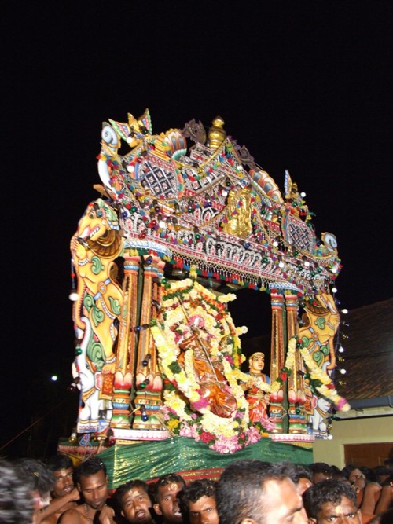
Isaiah 46:1-2 NRS Bel bows down, Nebo stoops, their idols are on beasts and cattle; these things you carry are loaded as burdens on weary animals. 2 They stoop, they bow down together; they cannot save the burden, but themselves go into captivity.

Slide 4
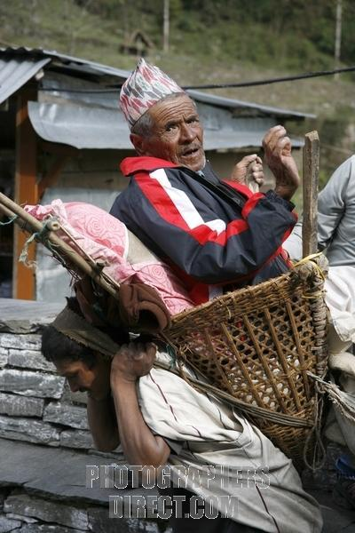
Isaiah 46:3-4 ³ Listen to me, O house of Jacob, all the remnant of the house of Israel, who have been borne by me from your birth, carried from the womb; ⁴ even to your old age I am he, even when you turn gray I will carry you. I have made, and I will bear; I will carry and will save.

Slide 5
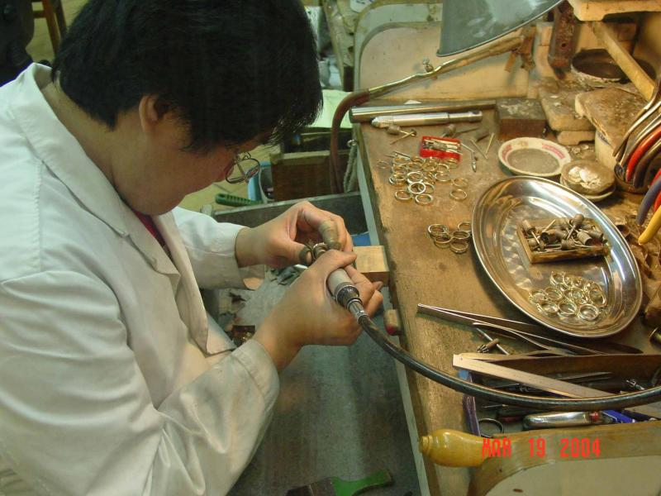
Isaiah 46:5-7 ⁵ To whom will you liken me and make me equal, and compare me, as though we were alike? ⁶ Those who lavish gold from the purse, and weigh out silver in the scales-- they hire a goldsmith, who makes it into a god; then they fall down and worship! ⁷ They lift it to their shoulders, they carry it, they set it in its place, and it stands there; it cannot move from its place. If one cries out to it, it does not answer or save anyone from trouble.

Slide 6
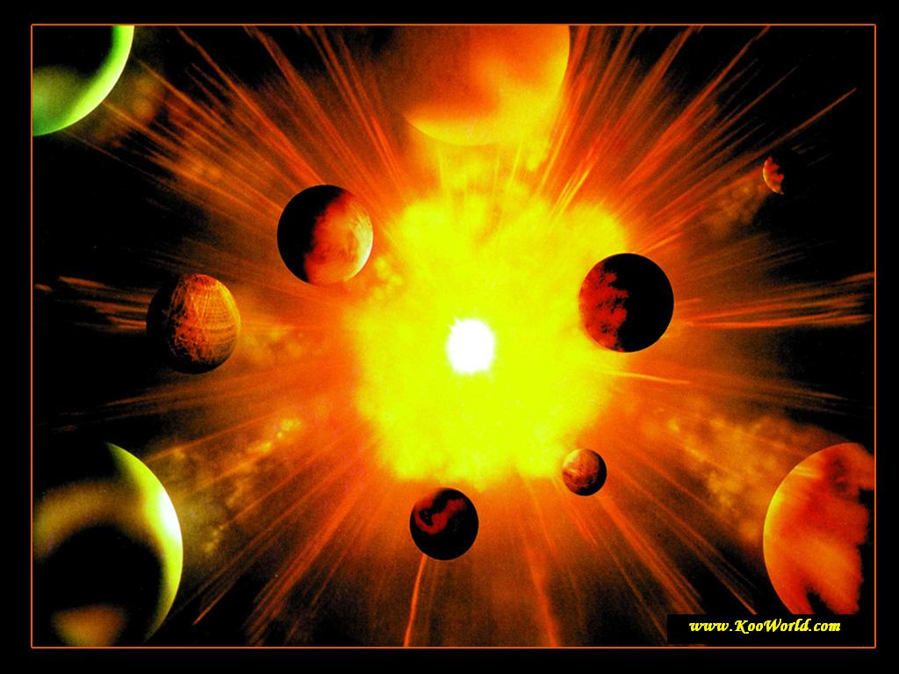
Isaiah 46:8-10 ⁸ Remember this and consider, recall it to mind, you transgressors, ⁹ remember the former things of old; for I am God, and there is no other; I am God, and there is no one like me, ¹⁰ declaring the end from the beginning and from ancient times things not yet done, saying, "My purpose shall stand, and I will fulfill my intention,"

Slide 7
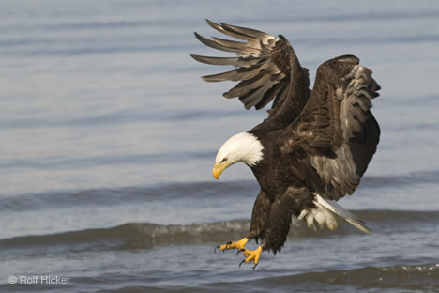
Isaiah 46:11-13 ¹¹ calling a bird of prey from the east, the man for my purpose from a far country. I have spoken, and I will bring it to pass; I have planned, and I will do it. ¹² Listen to me, you stubborn of heart, you who are far from deliverance: ¹³ I bring near my deliverance, it is not far off, and my salvation will not tarry; I will put salvation in Zion, for Israel my glory.

Slide 8
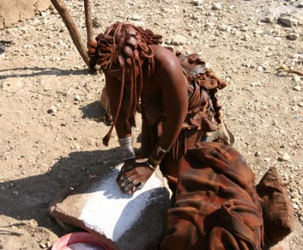
Isaiah 47:1-4 ^{NRS} Come down and sit in the dust, virgin daughter Babylon! Sit on the ground without a throne, daughter Chaldea! For you shall no more be called tender and delicate. ² Take the millstones and grind meal, remove your veil, strip off your robe, uncover your legs, pass through the rivers. ³ Your nakedness shall be uncovered, and your shame shall be seen. I will take vengeance, and I will spare no one. ⁴ Our Redeemer-- the LORD of hosts is his name-- is the Holy One of Israel.

Slide 9
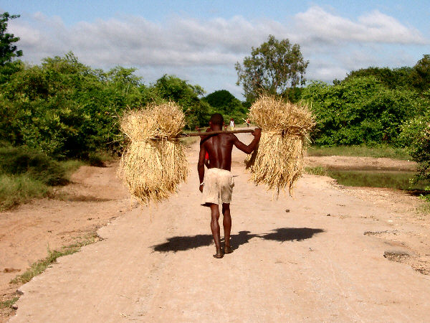
Isaiah 47:5-6 ⁵ Sit in silence, and go into darkness, daughter Chaldea! For you shall no more be called the mistress of kingdoms. ⁶ I was angry with my people, I profaned my heritage; I gave them into your hand, you showed them no mercy; on the aged you made your yoke exceedingly heavy.

Slide 10
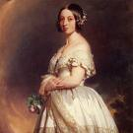
Isaiah 47:7 ⁷ You said, "I shall be mistress forever," so that you did not lay these things to heart or remember their end.

Slide 11
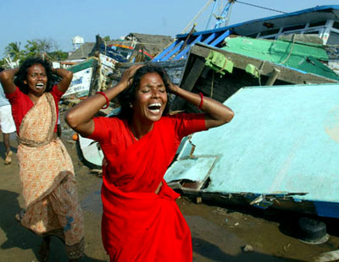
Isaiah 47:8-9 ⁸ Now therefore hear this, you lover of pleasures, who sit securely, who say in your heart, "I am, and there is no one besides me; I shall not sit as a widow or know the loss of children"-- ⁹ both these things shall come upon you in a moment, in one day: the loss of children and widowhood shall come upon you in full measure, in spite of your many sorceries and the great power of your enchantments.

Slide 12
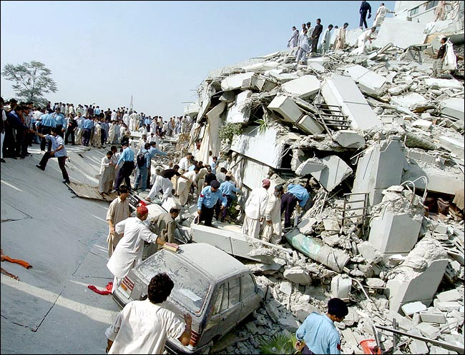
Isaiah 47:10-11 ¹⁰ You felt secure in your wickedness; you said, "No one sees me." Your wisdom and your knowledge led you astray, and you said in your heart, "I am, and there is no one besides me." ¹¹ But evil shall come upon you, which you cannot charm away; disaster shall fall upon you, which you will not be able to ward off; and ruin shall come on you suddenly, of which you know nothing.

Slide 13
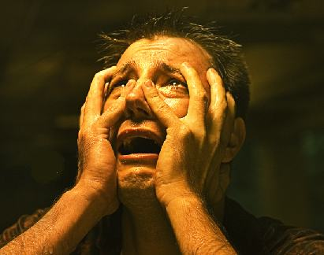
Isaiah 47:12-13 ¹² Stand fast in your enchantments and your many sorceries, with which you have labored from your youth; perhaps you may be able to succeed, perhaps you may inspire terror. ¹³ You are wearied with your many consultations; let those who study the heavens stand up and save you, those who gaze at the stars, and at each new moon predict what shall befall you.

Slide 14
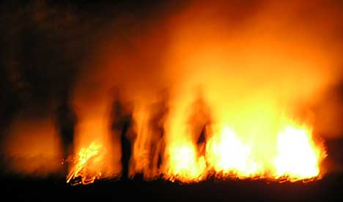
Isaiah 47:14 ¹⁴ See, they are like stubble, the fire consumes them; they cannot deliver themselves from the power of the flame. No coal for warming oneself is this, no fire to sit before!

Slide 15
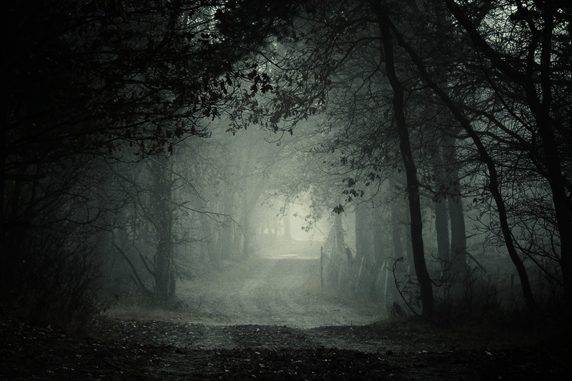
Isaiah 47:15 ¹⁵ Such to you are those with whom you have labored, who have trafficked with you from your youth; they all wander about in their own paths; there is no one to save you.

